Slide 1
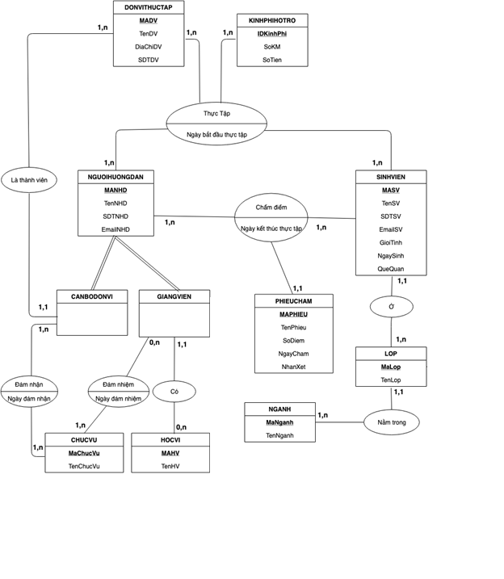
Số KM đem qua dvtt
User
Id
Email password
HoTen SDT TrangThai LoiGioiThieu
ThongBao
MaThongBao
Img
Title
Content
quote

